Slide 1
Migration & Eloquent ORM 2
Session 7
Course : COMP6821001 – Web Programming
Effective Period : 2023

Slide 2
Learning Outcomes
LO-3 : Identify a proper web programming technic to build web based application

Slide 3
Outline
Seeding & Faker
One-To-One relations
Many-To-Many relations
One-To-Many relations

Slide 4
Seeding & Faker
Seeding or Seeder can be said is a feature that can be used to input arbitrary data or data testing.
Whereas Faker is a library that is used to create fake data, where this faker library will be able to generate hundreds or even thousands of data randomly.
Seeder files are located in the Database directory where you have migrations, seeds and factories. On fresh installation of Laravel application there exists only one file in the seeds called DatabaseSeeder which is the base file to run other seeders and factories and looks like,

Slide 5
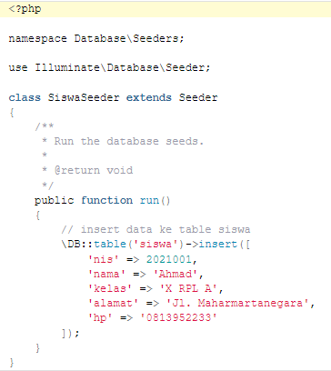
Seeding & Faker
To create a seeding, you must first create a seeder class with the following command:
  php artisan make:seeder SiswaSeeder
Cara menjalankan fungsi method run():
  Php artisan db:seed –class=SiswaSeeder

Slide 6
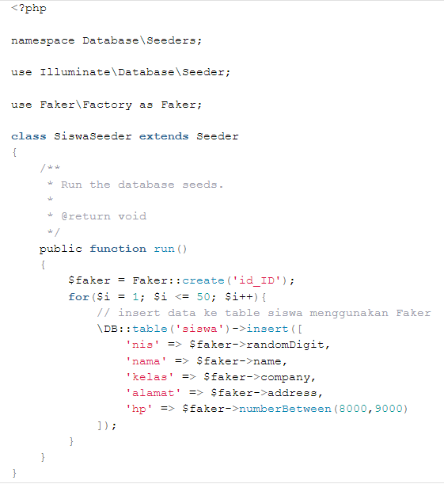
Seeding & Faker
For example, we need 50 student data to be used as testing data. Then we can make Fake data in the Seeder file SiswaSeeder.php that was created earlier. Type in the following syntax:
Run the SiswaSeeder.php file with the following command:
php artisan db:seed –class=SiswaSeeder

Slide 7
One To One Relations
A one-to-one relationship is a very basic relation. For example, a User model might be associated with one Phone. To define this relationship, we place a phone method on the User model. The phone method should call the hasOne method and return its result:
<?php
namespace App\Models;
use Illuminate\Database\Eloquent\Model;
class User extends Model
{
/**
* Get the phone associated with the user.
*/
public function phone()
{
return $this->hasOne(Phone::class);
}
}

Slide 8
One To One Relations
Defining The Inverse Of The Relationship. So, we can access the Phone model from our User. Now, let's define a relationship on the Phone model that will let us access the User that owns the phone. We can define the inverse of a hasOne relationship using the belongsTo method:
<?php
namespace App\Models;
use Illuminate\Database\Eloquent\Model;
class Phone extends Model
{
/**
* Get the user that owns the phone.
*/
public function user()
{
return $this->belongsTo(User::class);
}
}

Slide 9
One To Many Relations
A one-to-many relationship is used to define relationships where a single model owns any amount of other models. For example, a blog post may have an infinite number of comments. Like all other Eloquent relationships, one-to-many relationships are defined by placing a function on your Eloquent model:
<?php
namespace App\Models;
use Illuminate\Database\Eloquent\Model;
class Post extends Model
{
/**
* Get the comments for the blog post.
*/
public function comments()
{
return $this->hasMany(Comment::class);
}
}

Slide 10
One To Many Relations
One To Many (Inverse). Now that we can access all of a post's comments, let's define a relationship to allow a comment to access its parent post. To define the inverse of a hasMany relationship, define a relationship function on the child model which calls the belongsTo method:
<?php
namespace App\Models;
use Illuminate\Database\Eloquent\Model;
class Comment extends Model
{
/**
* Get the post that owns the comment.
*/
public function post()
{
return $this->belongsTo(Post::class);
}
}

Slide 11
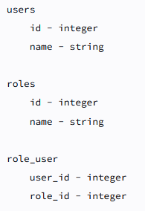
Many To Many Relations
Many-to-many relations are slightly more complicated than hasOne and hasMany relationships. An example of a many-to-many relationship is a user that has many roles and those roles are also shared by other users in the application. For example, a user may be assigned the role of "Author" and "Editor"; however, those roles may also be assigned to other users as well. So, a user has many roles and a role has many users.
Fig 13. relationship's table structure

Slide 12
Many To Many Relations
Many-to-many relationships are defined by writing a method that returns the result of the belongsToMany method. The belongsToMany method is provided by the Illuminate\Database\Eloquent\Model base class that is used by all of your application's Eloquent models
<?php
namespace App\Models;
use Illuminate\Database\Eloquent\Model;
class User extends Model
{
/**
* The roles that belong to the user.
*/
public function roles()
{
return $this->belongsToMany(Role::class);
}
}

Slide 13
Many To Many Relations
To define the "inverse" of a many-to-many relationship, you should define a method on the related model which also returns the result of the belongsToMany method. To complete our user / role example, let's define the users method on the Role model:
<?php
namespace App\Models;
use Illuminate\Database\Eloquent\Model;
class Role extends Model
{
/**
* The users that belong to the role.
*/
public function users()
{
return $this->belongsToMany(User::class);
}
}

Slide 14
Soft Deletes
In addition to actually removing records from your database, Eloquent can also "soft delete" models. When models are soft deleted, they are not actually removed from your database. Instead, a deleted_at attribute is set on the model indicating the date and time at which the model was "deleted". To enable soft deletes for a model, add the Illuminate\Database\Eloquent\SoftDeletes trait to the model:
<?php
namespace App\Models;
use Illuminate\Database\Eloquent\Model;
use Illuminate\Database\Eloquent\SoftDeletes;
class Flight extends Model
{
use SoftDeletes;
}

Slide 15
References
Andy Turner. (2022). Laravel 9.x | PHP Learning Laravel with Easiest Way: The book will teach you Laravel 9.x step by step.
Andre Pratama. (2019). Laravel Uncover. DuniaIlkom.
http://agussuratna.net/2021/04/16/tutorial-laravel-8-seeding-dan-faker-pada-laravel/
https://laravel.com/docs/8.x/eloquent-relationships#one-to-one
https://laravel.com/docs/8.x/eloquent-relationships#one-to-many
https://laravel.com/docs/8.x/eloquent-relationships#many-to-many
https://laravel.com/docs/8.x/eloquent#soft-deleting
https://www.youtube.com/watch?v=g-63ClKANsM

Slide 16
Thank You

